Slide 1
FUNDAMENTALS OF WEB TECHNOLOGIES
Mr. Putcha Saikiran

Slide 2
Syllabus :
Unit-I
HTML Over view, HTML Document Structure, HTML Tags, HTML Elements, HTML Attributes, HTML Formatting, Grouping Content, HTML Fonts, HTML Color, HTML Images, HTML Tables, HTML List, HTML Text Link, HTML Frames, HTML IFrames, HTML Header, tag, The <marquee> Tag Attributes
Unit-II
HTML Backgrounds, HTML Layout, HTML Forms, Form Attributes, HTML Form Controls, Text Input Controls, Single-line text input controls, CSS introduction, CSS Syntax, Concept of CSS: Creating Style Sheet, CSS Properties, CSS Styling, Working with Lists and Tables, CSS Id and Class, Creating page Layout and Site Designs CSS style sheet: External Style Sheets, Internal Style Sheets, Inline Style, The class selector: div & span tag. DOM HTML DOM, inner HTML, Dynamic HTML (DHTML), DHTML form, XML DOM

Slide 3
Unit-III
Java Script Overview, Syntax, Enabling Using Web browser, Placement, Java Script Variables, Operators, control structure, Function, Events Handling, DOM (Document Object Model), Array, String, Errors and Exceptions, Form Validation.Bootstrap Get Started, Basic Bootstrap Pages, Bootstrap Grids, Table, Responsive Images, Jumbotron and Page Header, Bootstrap Buttons, Button Groups, Dropdown Menus, Badges, Labels, List, Dropdowns Menus, Navigation Bar, Forms, Input
Unit-IV
Introduction to PHP, Decisions and loop. Function, String, Array, Looping with Index based array, Looping with associative array using each () and foreach(), Some useful Library function. Handling Html Form with Php, Database Connectivity with MySql, Introduction to RDBMS, Connection with MySql Database, Performing basic database operation(DML) (Insert, Delete, Update, Select), Setting query parameter.

Slide 4
Fundamentals of web technologies
UNIT - 1

Slide 5
HTML introduction:
HTML stands for Hyper Text Markup Language.
It is used to design web pages using a markup language.
HTML is the combination of Hypertext and Markup language.
Hypertext defines the link between web pages.
A markup language is used to define the text document within the tag which defines the structure of web pages.

Slide 6
This language is used to annotate (make notes for the computer) text so that a machine can understand it and manipulate text accordingly.
Most markup languages (e.g. HTML) are human-readable.
The language uses tags to define what manipulation has to be done on the text.

Slide 7
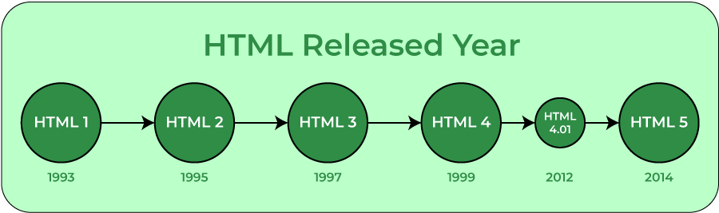
HTML is a markup language used by the browser to manipulate text, images, and other content, in order to display it in the required format.

Slide 8
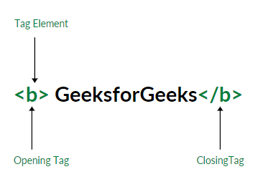
Tags and elements:
HTML uses predefined tags and elements which tell the browser how to properly display the content.
Remember to include closing tags. If omitted, the browser applies the effect of the opening tag until the end of the page.

Slide 9
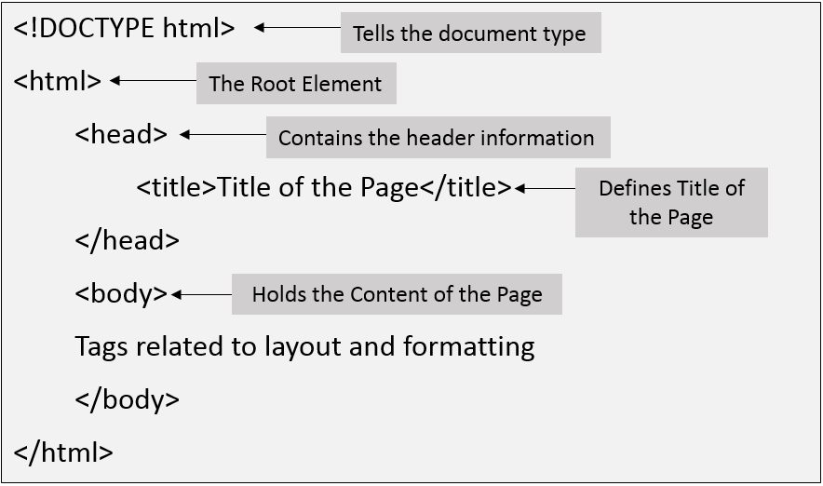
HTML structure:

Slide 10
<!DOCTYPE html>: This is the document type declaration (not technically a tag). It declares a document as being an HTML document. The doctype declaration is not case-sensitive.
<html>: This is called the HTML root element. All other elements are contained within it.
<head>: The head tag contains the “behind the scenes” elements for a webpage. Elements within the head aren’t visible on the front-end of a webpage.
<body>: The body tag is used to enclose all the visible content of a webpage. In other words, the body content is what the browser will show on the front-end.

Slide 11
Features of HTML
It is easy to learn and easy to use.
It is platform-independent.
Images, videos, and audio can be added to a web page.
Hypertext can be added to the text.
It is a markup language.

Slide 12
Why we learn HTML?
It is a simple markup language. Its implementation is easy.
It is used to create a website.
Helps in developing fundamentals about web programming.
Boost professional career.

Slide 13
Advantages and disadvantages
Advantages
Disadvantages
HTML is used to build websites.
It is supported by all browsers.
It can be integrated with other languages like CSS, JavaScript, etc.
HTML can only create static web pages. For dynamic web pages, other languages have to be used.
A large amount of code has to be written to create a simple web page.
The security feature is not good.

Slide 14
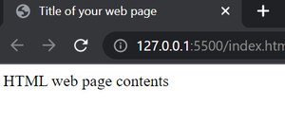
<html>
<head>
<title>Title of your web page</title>
</head>
<body>HTML web page contents </body>
</html>

Slide 15
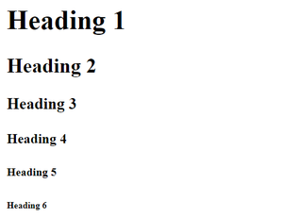
Head tag:
It is used to define the heading of an HTML document.
<h1>Heading 1 </h1>
<h2>Heading 2 </h2>
<h3>Heading 3 </h3>
<h4>Heading 4 </h4>
<h5>Heading 5 </h5>
<h6>Heading 6 </h6>

Slide 16
Paragraph tag:
It is used to define paragraph content in an HTML document.
<p>Paragraph you want to put</p>

Slide 17
HTML tags:
Bold tag: It is used to specify bold content in an HTML document.
<b> Statements... </b>
Italic tag: It is used to write the content in italic format.
<i> Statements... </i>
Underline tag: It is used to set the content underline.
<u> Statements... </u>

Slide 18
Deleted text tag: It is used to represent deleted text. It crosses the text content.
<strike>Trese</strike>Trees
Anchor tag: It is used to link one page to another page.
<a href="..."> Statements... </a>
Visit <a href="https://www.geeksforgeeks.org/"> GeeksforGeeks</a> for better experience.

Slide 19
HTML elements:
An HTML element is defined by a start tag, some content, and an end tag.
The HTML element is everything from the start tag to the end tag:
<tagname>Content goes here...</tagname>
HTML elements can be nested (this means that elements can contain other elements).
All HTML documents consist of nested HTML elements.
The following example contains: Basic HTML structure

Slide 20
HTML attributes:
HTML attributes provide additional information about HTML elements.
All HTML elements can have attributes
Attributes are always specified in the start tag
Attributes usually come in name/value pairs like: name="value"
<a href="https://www.w3schools.com">Visit W3Schools</a>

Slide 21
HTML formatting:
Formatting elements were designed to display special types of text:
<b> </b>- Bold text
<strong> </strong> - Important text
<i> </i>- Italic text
<em> </em> - Emphasized text (typically displayed in Italic)
<mark> </mark>- Marked text (marked or highlighted)
<small> </small> - Smaller text (smaller text size)
<del> </del>- Deleted text (crossed line over text)
<ins> </ins>- Inserted text (text inserted into document)
<sub> </sub>- Subscript text
<sup> </sup>- Superscript text

Slide 22
Grouping content:
Grouping plays a vital role in our web page because it helps the developer to target specific classes and id which makes it easier to position, style, or manipulate the web page with the help of HTML.

Slide 23
<div>: It is a block-level tag that groups various HTML tags into a single block.
<html>
<head> </head>
<body>
<div class="div1">
<h1>In Div1</h1>
</div>
<div class="div2">
<h1>In Div2</h1>
</div> </body> </html>
In DIV1
In DIV2

Slide 24
<header> :This tag contains the tagline or we can say it contains the main heading or the navigation links of our web page and is placed at the top of our web page. (written inside body)
<header>
<h1>This is Heading..</h1>
<p>This is paragraph in the header group</p>
</header>

Slide 25
<footer> : This tag contains copyright information, contact information, back-to-top link, and several other related documents and is placed at the bottom of our web page.
<footer>
<h1>Thank you</h1>
<p>You rechaed to the last page</p>
</footer>

Slide 26
<section> : This tag is used to define the section in the document.
<section id="sectionID">
<p>This content belongs to section group.</p>
<p>HTML is a hypertext markup language which is used to design the web pages</p>
</section>

Slide 27
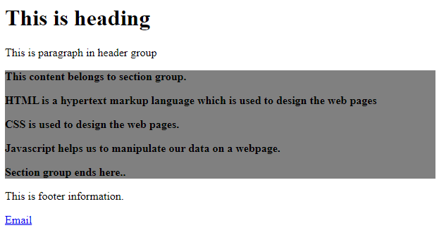
Example

Slide 28
HTML fonts:
Font tag: It is used to specify the font size, font color, and font family in an HTML document.
<font face="Times New Roman">Example</font>

Slide 29
HTML Colors:
HTML colors are specified with predefined color names.
Background color:
<h1 style="background-color:DodgerBlue;">SEC G</h1> <p style="background-color:Tomato;">Having FWT subject</p>

Slide 30
Text color:
<h1 style="color:DodgerBlue;">SEC G</h1> <p style="color:Tomato;">Having FWT subject</p>
Border color:
<h1 style="border:2px solid Tomato;“>SEC G</h1> <h1 style="border:2px solid Violet;">Hello World</h1>

Slide 31
HTML image:
The HTML <img> tag is used to embed an image in a web page.
The <img> tag has two required attributes:
src - Specifies the path to the image
alt - Specifies an alternate text for the image
<img src="img_chania.jpg" alt="Flowers in Chania">

Slide 32
Image height and width
<img src="img_girl.jpg" alt="Girl sitting" style="width:500px;height:600px;">
Image in another sub folder
<img src="/images/html5.gif" alt="HTML5 Icon" style="width:128px;height:128px;">

Slide 33
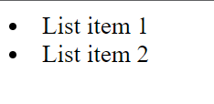
HTML Lists:
List tag: It is used to list the content.
<li>List item 1</li>
<li>List item 2</li>

Slide 34
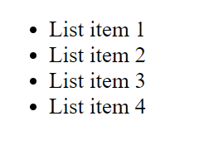
Types of Lists:
Unordered list: It is used to list the content without order.
<ul>
<li>List item 1</li>
<li>List item 2</li>
<li>List item 3</li>
<li>List item 4</li>
</ul>

Slide 35
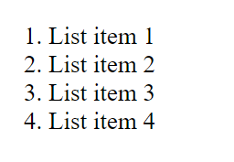
Ordered List tag: It is used to list the content in a particular order.
<ol>
<li>List item 1</li>
<li>List item 2</li>
<li>List item 3</li>
<li>List item 4</li>
</ol>

Slide 36
Comment tag: It is used to set the comment in an HTML document. It is not visible on the browser.
<!--Comment section-->
Center tag: It is used to set the content into the center.
<center>SAIKIRAN</center>
Line break tag: It is used to break the line.
This is BSH<br>not CSE

Slide 37
HTML Table:
Table tag: A table tag is used to create a table in an HTML document.
td tag: It defines the standard cell in a HTML document.
tr tag: It is used to define a row of an HTML table.
th tag: It defines the header cell in a table. By default, it set the content with the bold and center property.

Slide 38
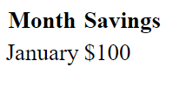
<table>
<tr>
<th>Month</th>
<th>Savings</th>
</tr>
<tr>
<td>January</td>
<td>$100</td>
</tr>
</table>

Slide 39

<table border="4" cellpadding="2" cellspacing="2" width="50%">
<tr> <td>Column 1</td>
<td>Column 2</td>
</tr>
</table>

Slide 40
Cell padding is the space between the cell edges and the cell content.
Cell spacing is the space between each cell.

Slide 41
Column span
specifies the number of columns a cell should span.
It allows the single table cell to span the width of more than one cell or column.
It provides the same functionality as “merge cell” in a spreadsheet program like Excel.
It can be used with <td>and <th> element while creating an HTML Table.
<td colspan = "value">table content...</td>

Slide 42
<table> <tr> <th colspan="2">Name</th> <th>Age</th> </tr> <tr> <td>Jill</td> <td>Smith</td> <td>43</td> </tr>
</table>

Slide 43
Row span
The rowspan attribute in HTML specifies the number of rows a cell should span.
That is if a row spans two rows, it means it will take up the space of two rows in that table.
It allows the single table cell to span the height of more than one cell or row.
It provides the same functionality as “merge cell” in the spreadsheet program like Excel.
It can be used with <td> and <th> element in an HTML Table.

Slide 44
<table> <tr> <th>Name</th> <th>Group</th>
<th>Section</th> </tr> <tr> <td>Jill</td> <td rowspan=“2”>G</td> </tr>
</table>

Slide 45
HTML text links:
A webpage can contain various links that take you directly to other pages and even specific parts of a given page. These links are known as hyperlinks.
Hyperlinks allow visitors to navigate between Web sites by clicking on words, phrases, and images. Thus you can create hyperlinks using text or images available on a webpage.
<a href = "Document URL" ... attributes-list>Link Text</a>

Slide 46
example
<html>
<head>
<title>Hyperlink Example</title> </head> <body>
<p>Click following link</p>
<a href = "https://www.tutorialspoint.com" target = "_self">Tutorials Point</a>
</body>
</html>

Slide 47
_blank
Opens the linked document in a new window or tab.
_self
Opens the linked document in the same frame.
_parent
Opens the linked document in the parent frame.
_top
Opens the linked document in the full body of the window.

Slide 48
HTML frames:
HTML <frame> tag define the particular area within an HTML file where another HTML web page can be displayed.
A <frame> tag is used with <frameset> , and it divides a webpage into multiple sections or frames, and each frame can contain different web pages.

Slide 49
< frame src = "URL" >
Two types of frames:
Vertical frames
Horizontal frames

Slide 50
Horizontal frame:
<html>
<head>
<title>Frame tag</title>
</head>
<frameset rows="30%, 40%, 30%">
<frame name="top" src="1.html" >
<frame name="main" src="2.html">
<frame name="bottom" src="3.html">
</frameset>
</html>

Slide 51
Vertical frames:
<html>
<head>
<title>Frame tag</title>
</head>
<frameset cols="25%,50%,25%">
<frame src="1.html" >
<frame src="2.html">
<frame src="3.html">
</frameset>
</html>

Slide 52
HTML iframes:
HTML Iframe is used to display a nested webpage (a webpage within a webpage). The HTML <iframe> tag defines an inline frame, hence it is also called as an Inline frame.
An HTML iframe embeds another document within the current HTML document in the rectangular region.
The webpage content and iframe contents can interact with each other using JavaScript.

Slide 53
<iframe src="URL"></iframe>
<iframe src="https://www.javatpoint.com/" height="300" width="400"></iframe>
<iframe src="https://www.javatpoint.com/" height="50%" width="70%"></iframe>
<iframe src="https://www.javatpoint.com/" style="border:none;"></iframe>

Slide 54
HTML header:
HTML <header> tag is used as a container of introductory content or navigation links. Generally a <header> element contains one or more heading elements, logo or icons or author's information.
You can use several <header> elements in one document, but a <header> element cannot be placed within a <footer>, <address> or another <header> element.

Slide 55
<header>
<h2>ABCOnline.com</h2>
<p> World's no.1 shopping website</p>
</header>

Slide 56
Marquee tag:
The Marquee HTML tag is a non-standard HTML element which is used to scroll a image or text horizontally or vertically.
In simple words, you can say that it scrolls the image or text up, down, left or right automatically.

Slide 57
<marquee width="100%" behavior="scroll" bgcolor="pink">
This is an example of a scroll marquee...
</marquee>
Slide and alternate
<marquee width="100%" direction="right">
This is an example of a right direction marquee...
</marquee>

Slide 58
UNIT-2

Slide 59
HTML background:
HTML Background with Colors
HTML Background with Images

Slide 60
Html Background with Colors
The bgcolor attribute is used to control the background of an HTML element, specifically page body and table backgrounds.
<tagname bgcolor = "color_value"...>

Slide 61
<!-- Format 1 - Use color name -->
<table bgcolor = "lime" >
<!-- Format 2 - Use hex value -->
<table bgcolor = "#f1f1f1" >
<!-- Format 3 - Use color value in RGB terms --> <table bgcolor = "rgb(0,0,120)" >

Slide 62
Html Background with Images
<tagname background = "Image URL"...>

Slide 63
HTML layout:
Page layout is the part of graphic design that deals with the arrangement of visual elements on a page. Page layout is used to make the web pages look better. It establishes the overall appearance, relative importance, and relationships between the graphic elements to achieve a smooth flow of information and eye movement for maximum effectiveness or impact.

Slide 64
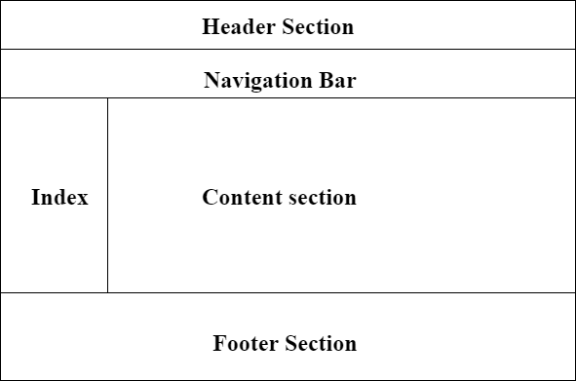

Slide 65
Header: The part of the front end which is used at the top of the page. <header> tag is used to add a header section on web pages.s
Navigation bar: The navigation bar is the same as the menu list. It is used to display the content information using hyperlinks. <nav> tag is used to add the nav section(nav elements) in web pages.
Index / Sidebar: It holds additional information or advertisements and is not always necessary to be added to the page.

Slide 66
Content Section: The content section is the central part where content is displayed.<main> tag is used to add the main content of the webpages.
Footer: The footer section contains the contact information and other query related to web pages. The footer section is always put on the bottom of the web pages. The <footer> tag sets the footer on web pages.

Slide 67
Header:
<!DOCTYPE html>
<html>
<head>
<title>Page Layout</title>
</head>
<body>
<!-- Header Section -->
<header style="background-color:DodgerBlue;">
<div class="head1">GeeksforGeeks</div>
<div class="head2">A computer science portal for geeks</div>
</header>

Slide 68
Navigation bar:
<!-- Menu Navigation Bar -->
<nav class="menu" style="background-color:Red;" >
<a href="#home">HOME</a>
<a href="#news">NEWS</a>
<a href="#notification">NOTIFICATIONS</a>
<div class="menu-log">
<a href="#login">LOGIN</a>
</div>
</nav>

Slide 69
Body section:
<!-- Body section -->
<main class = "body_sec" style="background-color:Green;" >
<section id="Content">
<h3>Content section</h3>
</section>
</main>

Slide 70
Footer section:
<!-- Footer Section -->
<footer style="background-color:Yellow;">Footer Section</footer>
</body>
</html>

Slide 71
HTML forms:
An HTML form is used to collect user input. The user input is most often sent to a server for processing.
The HTML <form> element is used to create an HTML form for user input:
<form> . form elements . </form>

Slide 72
The HTML <input> element is the most used form element.
An <input> element can be displayed in many ways, depending on the type attribute.
Types of inputs:
Text
Radio
Check box
Submit
Button
Dropdown box

Slide 73
Checkbox: It is used to define a checkbox field. The checkbox is shown as a square box that is ticked when it is activated. It allows the user to select one or more option among all the limited choices.
Radio button: It is used to define a Radio Button. Radio Buttons are used to let the user select exactly one option from a list of predefined options. Radio Button input controls are created by using the “input” element with a type attribute having value as “radio”.

Slide 74
Text: It is used to define a single-line text field . The default width of the text field is 20 characters.
Submit: It is used to define a submit button. It is used to submit all the user value to the form handler. The Form Handler is a server page that activates a script for processing all the input values.
Reset: It is used to defines a reset button. The reset button is used to reset all the form values to its initial values.

Slide 75
Drop down box:
The <select> element is used to create a drop-down list.
The id attribute is needed to associate the drop-down list with a label.
The <option> tags inside the <select> element define the available options in the drop-down list.
Tip: Always add the <label> tag for best accessibility practices!

Slide 76
date
The <input type="date"> is used for input fields that should contain a date.
color
The <input type="color"> is used for input fields that should contain a color.
email
The <input type="email"> is used for input fields that should contain an e-mail address.
Depending on browser support, the e-mail address can be automatically validated when submitted.

Slide 77
image
The <input type="image"> defines an image as a submit button.
The path to the image is specified in the src attribute.
password
<input type="password"> defines a password field:

Slide 78
file
The <input type="file"> defines a file-select field and a "Browse" button for file uploads.
quantity
The <input type="number"> defines a numeric input field.
You can also set restrictions on what numbers are accepted.

Slide 79
url
The <input type="url"> is used for input fields that should contain a URL address.
time
The <input type="time"> allows the user to select a time (no time zone).

Slide 80
telephone
The <input type="tel"> is used for input fields that should contain a telephone number.
Gsearch
The <input type="search"> is used for search fields (a search field behaves like a regular text field).

Slide 81
volume
The <input type=“volume"> is used to adjust volume.

Slide 82
HTML input attributes
value
The input value attribute specifies an initial value for an input field:
readonly
The input readonly attribute specifies that an input field is read-only.
A read-only input field cannot be modified (however, a user can tab to it, highlight it, and copy the text from it).

Slide 83
disabled
The input disabled attribute specifies that an input field should be disabled.
A disabled input field is unusable and un-clickable.
size
The input size attribute specifies the visible width, in characters, of an input field.
The default value for size is 20.

Slide 84
maxlength
The input maxlength attribute specifies the maximum number of characters allowed in an input field.
min and max
The input min and max attributes specify the minimum and maximum values for an input field.
The min and max attributes work with the following input types: number, range, date, datetime-local, month, time and week.

Slide 85
pattern
The input pattern attribute specifies a regular expression that the input field's value is checked against, when the form is submitted.
The pattern attribute works with the following input types: text, date, search, url, tel, email, and password.
required
The input required attribute specifies that an input field must be filled out before submitting the form.
The required attribute works with the following input types: text, search, url, tel, email, password, date pickers, number, checkbox, radio, and file.

Slide 86
step
The input step attribute specifies the legal number intervals for an input field.
Example: if step="3", legal numbers could be -3, 0, 3, 6, etc.
height and width
The input height and width attributes specify the height and width of an <input type="image"> element.

Slide 87
autocomplete
The input autocomplete attribute specifies whether a form or an input field should have autocomplete on or off.
Autocomplete allows the browser to predict the value. When a user starts to type in a field, the browser should display options to fill in the field, based on earlier typed values.

Slide 88
CSS
_{Cascading Style Sheet}

Slide 89
Introduction:
CSS stands for Cascading Style Sheets
CSS describes how HTML elements are to be displayed on screen, paper, or in other media
CSS saves a lot of work. It can control the layout of multiple web pages all at once

Slide 90
HTML vs CSS
HTML
CSS
HTML is a markup language used to define a structure of a web page.
It consists of tags inside which text is enclosed.
HTML doesn’t have further types.
CSS is a style sheet language used to style the web pages by using different styling features.
It consists of selectors and declaration blocks.
CSS can be internal or external depending upon the requirement.

Slide 91
We cannot use HTML inside a CSS sheet.
HTML is not used for presentation and visualization.
HTML doesn’t allow animations and transitions.
HTML files are saved with .htm or .html extension.
We can use CSS inside an HTML document.
CSS is used for presentation and visualization.
CSS allows animation and transitions which helps to improve the UI.
CSS files are saved with .css extension.

Slide 92
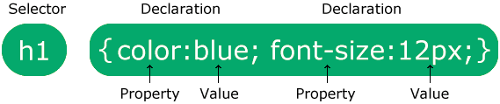

Slide 93
The selector points to the HTML element you want to style.
The declaration block contains one or more declarations separated by semicolons.
Each declaration includes a CSS property name and a value, separated by a colon.
Multiple CSS declarations are separated with semicolons, and declaration blocks are surrounded by curly braces.

Slide 94
<html> <head>
<style>
p {
color: red;
text-align: center;
}
</style>
</head> <body>
<p>Hello World!</p>
<p>These paragraphs are styled with CSS.</p>
</body> </html>

Slide 95
CSS element selector:
The element selector selects HTML elements based on the element name.

Slide 96
CSS id selector:
The id selector uses the id attribute of an HTML element to select a specific element.
The id of an element is unique within a page, so the id selector is used to select one unique element!
To select an element with a specific id, write a hash (#) character, followed by the id of the element.

Slide 97
CSS class selector:
The class selector selects HTML elements with a specific class attribute.
To select elements with a specific class, write a period (.) character, followed by the class name.

Slide 98
Class selector (vs) ID selector
Difference between Class and ID: A Class name can be used by multiple HTML elements, while an ID name must only be used by one HTML element within the page.

Slide 99
Background image and colour:
<style>
body {
background-image: url("paper.gif");
}
</style>

Slide 100
By default, the background-image property repeats an image both horizontally and vertically.
Showing the background image only once is also specified by the background-repeat property:
The background-position property is used to specify the position of the background image.
left top, left center, left bottom, right top, right center, right bottom, center top, center center, center bottom

Slide 101
The background-attachment property specifies whether the background image should scroll or be fixed (will not scroll with the rest of the page):
body { background-image: url("img_tree.png"); background-repeat: no-repeat; background-position: right top; background-attachment: fixed; }
fixed or scroll.

Slide 102
Multiple background images:
<style>
body {
background-image: url("img_tree.gif"), url("paper.gif");
background-repeat: no-repeat, repeat;
background-color: #cccccc;
}
</style>

Slide 103
CSS margins:
CSS has properties for specifying the margin for each side of an element:
margin-top
margin-right
margin-bottom
margin-left

Slide 104
<style>
body {
border: 1px solid black;
margin-top: 300px;
margin-bottom: 100px;
margin-right: 150px;
margin-left: 80px;
background-color: lightblue;
}
</style>

Slide 105
CSS lists:
The CSS list properties allow you to:
Set different list item markers for ordered lists
Set different list item markers for unordered lists
Set an image as the list item marker
Add background colors to lists and list items
Two types of lists:
Ordered list
Unordered list

Slide 106
The list-style-type property specifies the type of list item marker.
The list-style-image property specifies an image as the list item marker.
The list-style-position property specifies the position of the list-item markers (bullet points).
"list-style-position: outside;" means that the bullet points will be outside the list item. The start of each line of a list item will be aligned vertically.
list-style-position: inside;" means that the bullet points will be inside the list item. As it is part of the list item, it will be part of the text and push the text at the start:

Slide 107
CSS Tables:
To specify table borders in CSS, use the border property.
The example specifies a solid border for <table>, <th> and <td> elements:
table, th, td { border: 1px solid; }
table { width: 100%; }

Slide 108
Adjusting height
table { width: 100%; } th { height: 70px; }

Slide 109
Table alignment:
td { text-align: center; }
Vertical alignment:
The vertical-align property sets the vertical alignment (like top, bottom, or middle) of the content in <th> or <td>
td { height: 50px; vertical-align: bottom; }

Slide 110
Horizontal Alignment:
The text-align property sets the horizontal alignment (like left, right, or center) of the content in <th> or <td>.
By default, the content of <th> elements are center-aligned and the content of <td> elements are left-aligned.
To center-align the content of <td> elements as well, use text-align: center

Slide 111
Types of CSS:
There are three types of CSS which are given below:
Inline CSS
Internal or Embedded CSS
External CSS

Slide 112
Inline CSS: Inline CSS contains the CSS property in the body section attached with element is known as inline CSS. This kind of style is specified within an HTML tag using the style attribute.

Slide 113
Internal or Embedded CSS: This can be used when a single HTML document must be styled uniquely. The CSS rule set should be within the HTML file in the head section i.e the CSS is embedded within the HTML file.

Slide 114
External CSS: External CSS contains separate CSS file which contains only style property with the help of tag attributes (For example class, id, heading, … etc). CSS property written in a separate file with .css extension and should be linked to the HTML document using link tag. This means that for each element, style can be set only once and that will be applied across web pages. Example: The file given below contains CSS property. This file save with .css extension. For Ex: geeks.css

Slide 115
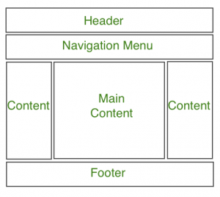
CSS layout:

Slide 116
CSS links:
The four links states are:
a:link - a normal, unvisited link
a:visited - a link the user has visited
a:hover - a link when the user grags mouse over it
a:active - a link the moment it is clicked
<html>
<head>
<style>

Slide 117
/* unvisited link */ a:link { color: red; } /* visited link */ a:visited { color: green; }

Slide 118
/* mouse over link */ a:hover { color: hotpink; } /* selected link */ a:active { color: blue; }

Slide 119
</style>
</head>
<body>
<a href="default.asp" >This is a link</a>
</body>
</html>

Slide 120
div and span
The div tag is a block level HTML element. It is used to divide or section other HTML elements into groups.

Slide 121
<html>
<head> <style>
div.sample {width:150px;background:#FF0002;border:2px dotted black;padding:7px;}
div.sample ul {color:green;}
</style> </head>
<body>
<div class="sample"> <p>Samplep> <ul> <li>Home</li> <li>Aboutus</li> <li>Contactus</li> </ul> </div>
</body> </html>

Slide 122
span tag is used for some hexadecimal codes like six-digit codes that represent the amount of color is also specified the percentage values.

Slide 123
<html> <body>
<p>Sample<span style="color:#FF0002;"> <i>Welcome</span></i>
Welcome My Domain</p>
<p><span style="color:#8865ff;"> Welcome to My Domain</span></p>
</body> </html>

Slide 124
JAVA SCRIPT

Slide 125
Java script:
Java Script is one popular scripting language over internet. Scripting means a small sneak (piece). It is always independent on other languages.
JavaScript is most commonly used as a client side scripting language. This means that JavaScript code is written into an HTML page. When a user requests an HTML page with JavaScript in it, the script is sent to the browser and it's up to the browser to do something with it.

Slide 126
Why we Use JavaScript?
Using HTML we can only design a web page but you can not run any logic on web browser like addition of two numbers, check any condition, looping statements (for, while), decision making statement (if-else) at client side. All these are not possible using HTML So for perform all these task at client side you need to use JavaScript.

Slide 127
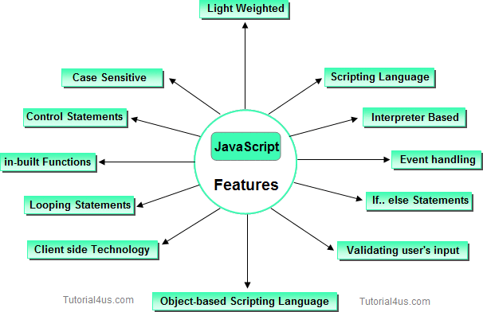
Features:

Slide 128
Placement:
In head
<html>
<head>
<script>
Code here
</script>
</head>
<body>
</body>
</html>

Slide 129
In body
<html>
<head>
</head>
<body>
<script>
Code here
</script>
</body>
</html>

Slide 130
Both in head and body
<html>
<head>
<script>
Script code here
</script>
</head>
<body>
<script>
Script code here
</script>
</body>
</html>

Slide 131
External file
<html> <head>
<script src = "filename.js" >
</script>
</head>
<body> ....... </body>
</html>
Linking of an external file with filename.js using the src attribute.

Slide 132
function sayHello()
{
alert("Hello World")
}
( external file with file name filename.js in the previous slide)

Slide 133
Javascript outputs:
Writing into an HTML element, using innerHTML
Writing into the HTML output using document.write()
Writing into an alert box, using window.alert()
Writing into the browser console, using console.log()

Slide 134
Method 1:
To access an HTML element, JavaScript can use the document.getElementById(id) method.
The id attribute defines the HTML element.

Slide 135
<!DOCTYPE html> <html> <body> <h1>My First Web Page</h1> <p>My First Paragraph</p> <p id="demo"></p> <script> document.getElementById("demo").innerHTML = 5 + 6; </script> </body> </html>

Slide 136
Method 2:
For testing purposes, it is convenient to use document.write()

Slide 137
<!DOCTYPE html> <html> <body> <h1>My First Web Page</h1> <p>My first paragraph.</p> <script> document.write(5 + 6); </script> </body> </html>

Slide 138
Method 4:
You will get the result by clicking on the button.

Slide 139
<!DOCTYPE html> <html> <body> <h1>My First Web Page</h1> <p>My first paragraph.</p> <button type="button" onclick="document.write(5 + 6)">Try it</button> </body> </html>

Slide 140
Method 5:
You can use an alert box to display data

Slide 141
<!DOCTYPE html> <html> <body> <h1>My First Web Page</h1> <p>My first paragraph.</p> <script> window.alert(5 + 6); </script> </body> </html>

Slide 142
Method 6:
You can skip the window keyword.
In JavaScript, the window object is the global scope object. This means that variables, properties, and methods by default belong to the window object. This also means that specifying the window keyword is optional

Slide 143
<!DOCTYPE html> <html> <body> <h1>My First Web Page</h1> <p>My first paragraph.</p> <script> alert(5 + 6); </script> </body> </html>

Slide 144
Enabling using web browser
Activate JavaScript in Google Chrome
Open Chrome on your computer.
Click Settings.
Click Security and Privacy.
Click Site settings.
Click JavaScript.
Select Sites can use Javascript.
https://www.enable-javascript.com/

Slide 145
Java Script Variables:
Variables are containers for storing data (storing data values).
4 Ways to Declare a JavaScript Variable:
Using var
Using let
Using const
Using nothing

Slide 146
Variables defined with let cannot be Redeclared.
Variables defined with let must be Declared before use.
let x = "John Doe";
let x = 0;
// SyntaxError: 'x' has already been declared

Slide 147
Variables defined with const cannot be Redeclared.
Variables defined with const cannot be Reassigned.
const PI = 3.141592653589793;
PI = 3.14; // This will give an error
PI = PI + 10; // This will also give an error

Slide 148
If you want a general rule: always declare variables with const.
If you think the value of the variable can change, use let.

Slide 149
<html> <body>
<h1>JavaScript Variables</h1>
<p>In this example, x, y, and z are variables.</p>
<script>
var x = 5;
var y = 6;
var z = x + y;
document.write("The value of z is: " + z);
</script>
</body> </html>

Slide 150
<html> <body>
<h1>JavaScript Variables</h1>
<p>In this example, x, y, and z are variables.</p>
<script>
let x = 5;
let y = 6;
let z = x + y;
document.write("The value of z is: " + z);
</script>
</body> </html>

Slide 151
<html> <body>
<h1>JavaScript Variables</h1>
<p>In this example, x, y, and z are variables.</p>
<p id="demo"></p>
<script>
x = 5;
y = 6;
z = x + y;
document.getElementById("demo").innerHTML =
"The value of z is: " + z;
</script>
</body> </html>

Slide 152
<html> <body>
<h1>JavaScript Variables</h1>
<p>In this example, price1, price2, and total are variables.</p>
<p id="demo"></p>
<script>
const price1 = 5;
const price2 = 6;
let total = price1 + price2;
document.getElementById("demo").innerHTML =
"The total is: " + total;
</script>
</body> </html>

Slide 153
If you want a general rule: always declare variables with const.
If you think the value of the variable can change, use let.
The two variables price1 and price2 are declared with the const keyword.
These are constant values and cannot be changed.
The variable total is declared with the let keyword.
This is a value that can be changed.

Slide 154
Javascript operators
Types of JavaScript Operators
Arithmetic Operators
Assignment Operators
Comparison Operators
Logical Operators
Conditional Operators
Type Operators

Slide 155
Conditional statements
Use if to specify a block of code to be executed, if a specified condition is true
Use else to specify a block of code to be executed, if the same condition is false
Use else if to specify a new condition to test, if the first condition is false
Use switch to specify many alternative blocks of code to be executed

Slide 156
<html>
<body>
<script>
const time = 22;
let greeting;
if (time < 10) {
greeting = "Good morning";
} elseif (time < 20) {
greeting = "Good day";
} else {
greeting = "Good evening";
}
document.write(greeting);
</script> </body></html>

Slide 157
Switch case
<script>
let day;
switch (new Date().getDay()) {
case 0:
day = "Sunday";
break;
case 1:
day = "Monday";
break;
case 2:
day = "Tuesday";
break;

Slide 158
case 3:
day = "Wednesday";
break;
case 4:
day = "Thursday";
break;
case 5:
day = "Friday";
break;
case 6:
day = "Saturday";
}
document.write("Today is " + day);
</script>

Slide 159
Strings
A JavaScript string is zero or more characters written inside quotes.
let text = "John Doe";

Slide 160
String Length:
<html>
<body>
<script>
let text = "ABCDEFGHIJKLMNOPQRSTUVWXYZ";
document.write(text.length);
</script>
</body>
</html>

Slide 161
JavaScript Strings as Objects:
But strings can also be defined as objects with the keyword new:
<html>
<body>
<script>
// x is a string
let x = "John";
// y is an object
let y = new String("John");
document.write(typeof x + "<br>" + typeof y);
</script>
</body>
</html>

Slide 162
Javascript functions:
A JavaScript function is a block of code designed to perform a particular task.
<html>
<body>
<script>
function myFunction(p1, p2) {
return p1 * p2;
}
document.write(myFunction(4, 3));
</script>
</body>
</html>

Slide 163
Extracting String Parts:
There are 3 methods for extracting a part of a string:
slice(start, end)
substring(start, end)
substr(start, length)

Slide 164
<html>
<body>
<script>
let text = "Apple,Banana,Kiwi";
let part = text.slice(7,13);
document.write(part);
</script>
</body>
</html>

Slide 165
<html>
<body>
<script>
let text = "Apple,Banana,Kiwi";
let part = text.slice(7);
document.write(part);
</script>
</body>
</html>

Slide 166
<html>
<body>
<script>
let text = "Apple, Banana, Kiwi";
let part = text.slice(-12);
document.write(part);
</script>
</body>
</html>

Slide 167
<html>
<body>
<script>
let text = "Apple, Banana, Kiwi";
let part = text.slice(-12,-6);
document.write(part);
</script>
</body>
</html>

Slide 168
Replacing String Content:
let text = "Please visit Microsoft"; let newText = text.replace("Microsoft", "W3Schools");
text = text.replaceAll("cats","dogs");

Slide 169
let text1 = "Hello World!"; let text2 = text1.toUpperCase();
let text1 = "Hello World!"; // String let text2 = text1.toLowerCase(); // text2 is text1 converted to lower

Slide 170
JavaScript String concat()
<html>
<body>
<script>
let text1 = "Hello";
let text2 = "World!";
let text3 = text1.concat(" ",text2);
document.write(text3);
</script>
</body>
</html>

Slide 171
Adding JavaScript Strings
let text1 = "John"; let text2 = "Doe"; let text3 = text1 + " " + text2;
let text1 = "What a very "; text1 = text1+ "nice day";

Slide 172
Arrays:
An array is a special variable, which can hold more than one value:
const cars = ["Saab", "Volvo", "BMW"];

Slide 173
<html>
<body>
<h2>JavaScript Arrays</h2>
<script>
const cars = ["Saab", "Volvo", "BMW"];
document.write(cars);
</script>
</body>
</html>

Slide 174
Assigning values using index number:
<html>
<body>
<h2>JavaScript Arrays</h2>
<script>
const cars = [];
cars[0]= "Saab";
cars[1]= "Volvo";
cars[2]= "BMW";
document.write(cars);
</script>
</body>
</html>

Slide 175
Using the JavaScript Keyword new:
<html>
<body>
<script>
const cars = new Array("Saab", "Volvo", "BMW");
document.write(cars);
</script>
</body>
</html>

Slide 176
Accessing Array Elements:
<html>
<body>
<script>
const cars = ["Saab", "Volvo", "BMW"];
document.write(cars[0]);
</script>
</body>
</html>

Slide 177
Changing an Array Element:
<html>
<body>
<script>
const cars = ["Saab", "Volvo", "BMW"];
cars[0] = "Opel";
document.write(cars);
</script>
</body>
</html>

Slide 178
Arrays are Objects:
Objects use names to access its "members".
<html>
<body>
<script>
const person = {firstName:"John", lastName:"Doe", age:46};
document.write(person.firstName);
</script>
</body>
</html>

Slide 179
Array Properties and Methods:
The length Property
<html>
<body>
<script>
const fruits = ["Banana", "Orange", "Apple", "Mango"];
document.write(fruits.length);
</script>
</body>
</html>

Slide 180
Accessing the Last Array Element:
<html>
<body>
<script>
var fruits = ["Banana", "Orange", "Apple", "Mango"];
document.write(fruits[fruits.length-1]);
</script>
</body>
</html>

Slide 181
Looping Array Elements:
<html>
<body>
<script>
const fruits = ["Banana", "Orange", "Apple", "Mango"];
let fLen = fruits.length;
let text = "<ul>";
for (let i = 0; i < fLen; i++) {
text += "<li>" + fruits[i] + "</li>";
}
text += "</ul>";
document.write(text);
</script>
</body>
</html>

Slide 182
JavaScript Events
HTML events are "things" that happen to HTML elements.
When JavaScript is used in HTML pages, JavaScript can "react" on these events.

Slide 183
HTML Events
An HTML event can be something the browser does, or something a user does.
Here are some examples of HTML events:
An HTML web page has finished loading
An HTML input field was changed
An HTML button was clicked

Slide 184
<element event='some JavaScript'>
<element event="some JavaScript">

Slide 185
Events and description
onclick:The user clicks an HTML element
onmouseover: The user moves the mouse over an HTML element
onmouseout:The user moves the mouse away from an HTML element
onkeydown:The user pushes a keyboard key

Slide 186
<html>
<body>
<button onclick="document.write(Date())">
The time is?</button>
</body>
</html>

Slide 187
Adding two numbers:
<html><body>
<h2>JavaScript HTML Events</h2>
<button onclick="this.innerHTML=num3">Sum is</button>
<script>
let num1 = prompt("Please enter your num1");
let num2 = prompt("Please enter your num2");
let num3 = parseInt(num1) + parseInt(num2);
</script>
</body></html>

Slide 188
PHP
Hypertext pre-processor

Slide 189
Introduction:
PHP is an acronym for "PHP: Hypertext Preprocessor"
PHP is a widely-used, open source scripting language
PHP scripts are executed on the server
PHP is free to download and use
Notes:
Open source software is code that is designed to be publicly accessible—anyone can see, modify, and distribute the code as they see fit.

Slide 190
What is a PHP File?
PHP files can contain text, HTML, CSS, JavaScript, and PHP code
PHP code is executed on the server, and the result is returned to the browser as plain HTML
PHP files have extension ".php"

Slide 191
Why PHP ?
PHP runs on various platforms (Windows, Linux, Unix, Mac OS X, etc.)
PHP is compatible with almost all servers used today (Apache, IIS, etc.)
PHP supports a wide range of databases
PHP is easy to learn and runs efficiently on the server side

Slide 192
PHP Syntax
<!DOCTYPE html> <html> <body> <h1>My first PHP page</h1> <?php echo "Hello World!"; ?> </body> </html>

Slide 193
Declaring variables:
<?php
$txt = "Hello world!";
$x = 5;
$y = 10.5;
echo $txt;
echo "<br>";
echo $x;
echo "<br>";
echo $y;
?>

Slide 194
Decisions :
<?php $t = 25; if ($t < "10") { echo "Have a good morning!"; } elseif ($t < "20") { echo "Have a good day!"; } else { echo "Have a good night!"; } ?>

Slide 195
Switch case:
<?php $favcolor = "red"; switch ($favcolor) { case "red": echo "Your favorite color is red!"; break; case "blue": echo "Your favorite color is blue!"; break; case "green": echo "Your favorite color is green!"; break; default: echo "Your favorite color is neither red, blue, nor green!"; } ?>

Slide 196
Loops:
while - loops through a block of code as long as the specified condition is true
do...while - loops through a block of code once, and then repeats the loop as long as the specified condition is true
for - loops through a block of code a specified number of times
foreach - loops through a block of code for each element in an array

Slide 197
The foreach loop works only on arrays, and is used to loop through each key/value pair in an array.
<?php $colors = array("red", "green", "blue", "yellow"); foreach ($colors as $value) { echo "$value <br>"; } ?>

Slide 198
Functions:
<!DOCTYPE html>
<html>
<body>
<?php
function writeMsg() {
echo "Hello world!";
}
writeMsg();
?>
</body>
</html>

Slide 199
Functions with arguments:
<?php function familyName($fname, $year) { echo "$fname Refsnes. Born in $year <br>"; } familyName("Hege", "1975"); familyName("Stale", "1978"); familyName("Kai Jim", "1983"); ?>

Slide 200
Strings:
The PHP strlen() function returns the length of a string.
<?php echo strlen("Hello world!"); // outputs 12 ?>
The PHP str_word_count() function counts the number of words in a string.
<?php echo str_word_count("Hello world!"); // outputs 2 ?>

Slide 201
The PHP strrev() function reverses a string.
<?php echo strrev("Hello world!"); // outputs !dlrow olleH ?>
The PHP str_replace() function replaces some characters with some other characters in a string.
<?php echo str_replace("world", "Dolly", "Hello world!"); // outputs Hello Dolly! ?>

Slide 202
Arrays:
In PHP, there are three types of arrays:
Indexed arrays - Arrays with a numeric index
Associative arrays - Arrays with named keys
Multidimensional arrays - Arrays containing one or more arrays

Slide 203
Indexed arrays:
$cars = array("Volvo", "BMW", "Toyota");
$cars[0] = "Volvo"; $cars[1] = "BMW"; $cars[2] = "Toyota";
<?php $cars = array("Volvo", "BMW", "Toyota"); echo "I like " . $cars[0] . ", " . $cars[1] . " and " . $cars[2] . "."; ?>

Slide 204
Associative array:
Associative arrays are arrays that use named keys that you assign to them.
<?php $age = array("Peter"=>"35", "Ben"=>"37", "Joe"=>"43"); echo "Peter is " . $age['Peter'] . " years old."; ?>

Slide 205
Multidimensional array:
<?php
$cars = array (
array("Volvo",22,18),
array("BMW",15,13),
array("Saab",5,2),
array("Land Rover",17,15)
);
echo $cars[0][0].": In stock: ".$cars[0][1].", sold: ".$cars[0][2].".<br>";
echo $cars[1][0].": In stock: ".$cars[1][1].", sold: ".$cars[1][2].".<br>";
echo $cars[2][0].": In stock: ".$cars[2][1].", sold: ".$cars[2][2].".<br>";
echo $cars[3][0].": In stock: ".$cars[3][1].", sold: ".$cars[3][2].".<br>";
?>

